Slide 1
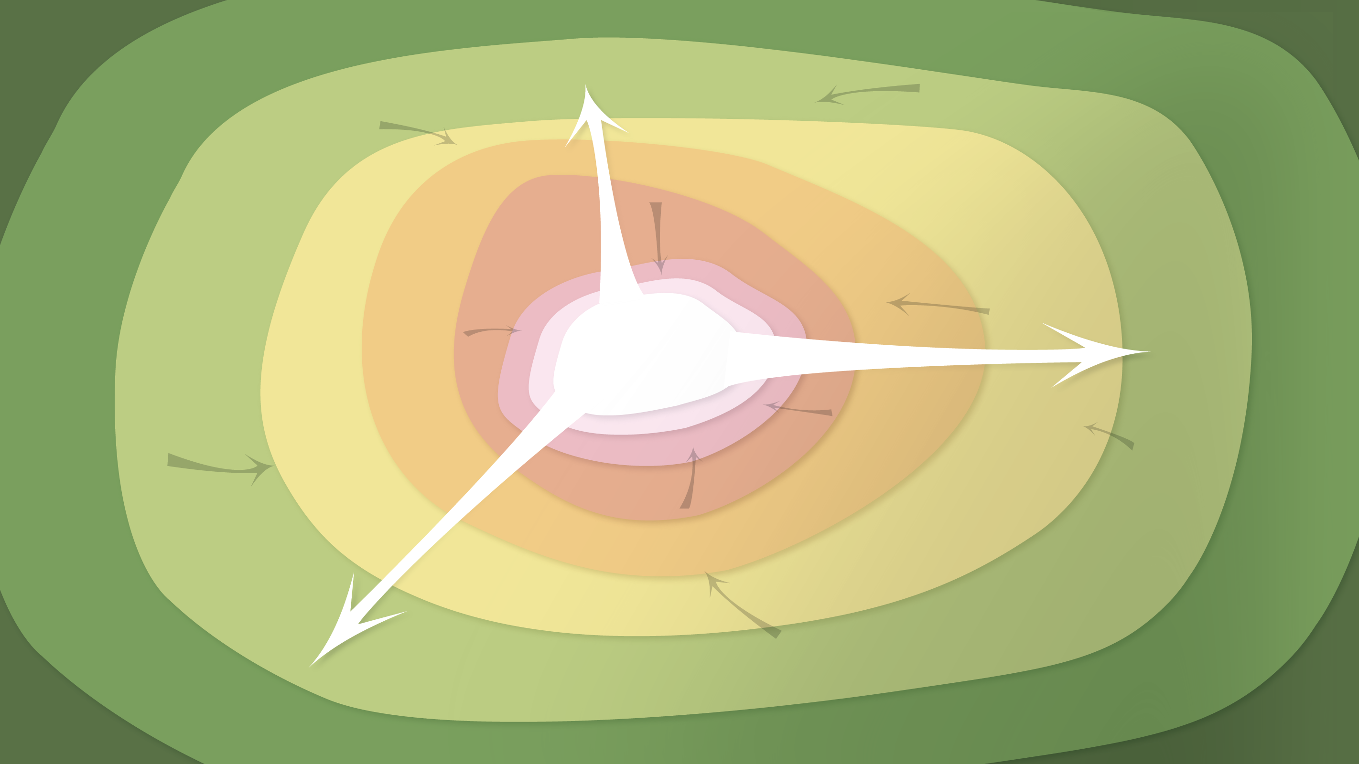
Data Management in the Research Environment
RSM 574/674 Spring 2016
Timothy Norris – tnorris@miami.edu
Angela Clark – aclark@rsmas.miami.edu

Slide 2
Administrative Stuff
The midterm project will be due Wednesday March 2nd
Sorry for any confusion
It is confirmed that the software Carpentry Workshops will be as follows
R – March 14th and 15th (two day workshop)
Python – March 28th and 29th (two day workshop)
You will attend one of these (your choice)
please talk to us soon if this will create difficulties/conflicts with other obligations/classes
Office hours all by appointment: tnorris@miami.edu or aclark@rsmas.miami.edu

Slide 3
Today’s outline
Research Data Lifecycle
A little more on Open Data
Data Management Plans

Slide 4
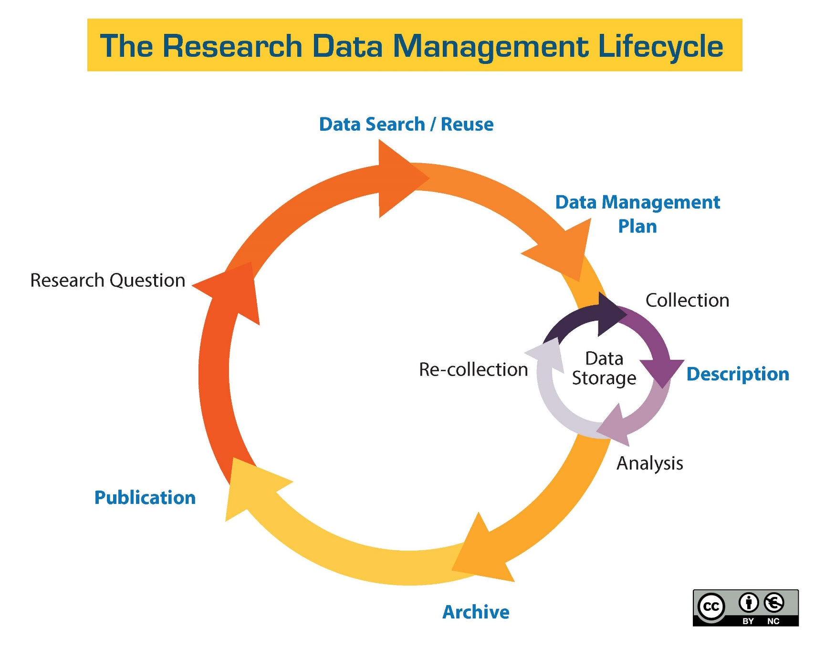
http://guides.library.ucsc.edu/datamanagement/

Slide 5
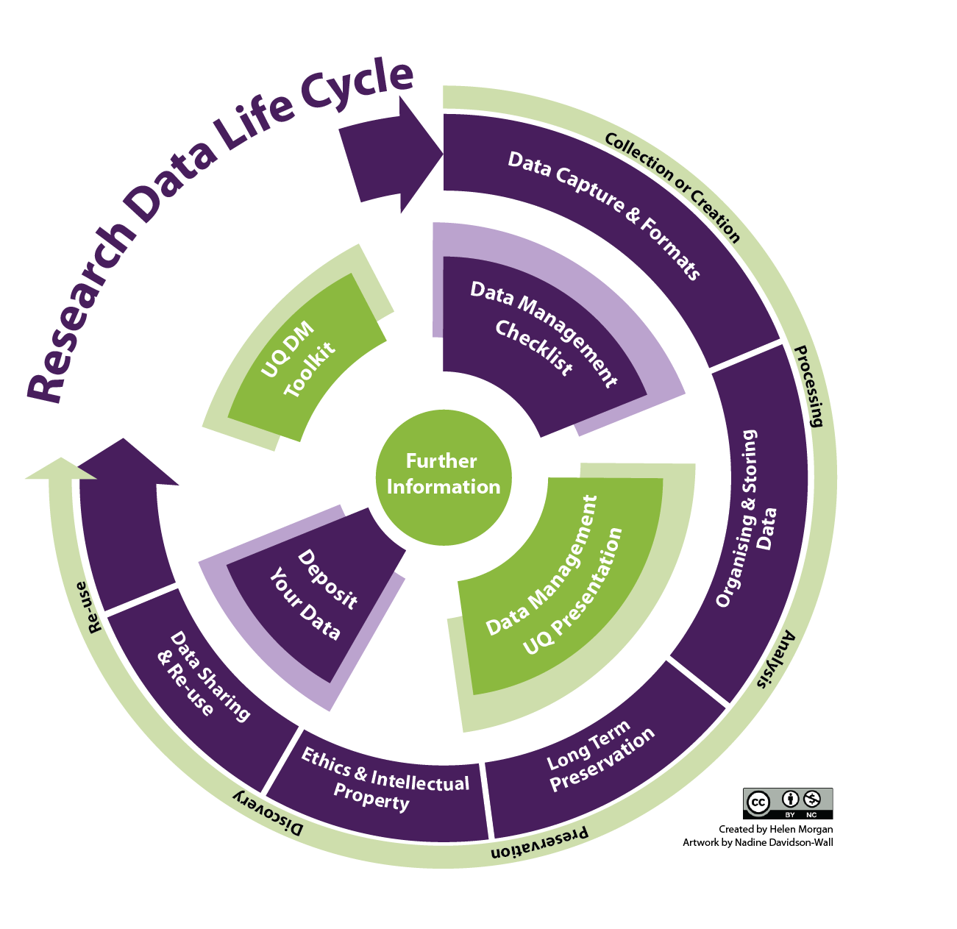
http://libguides.ucd.ie/data

Slide 6
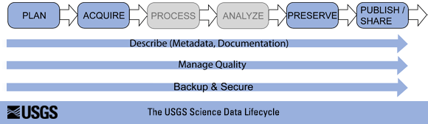
Research Data Lifecycle
http://www.usgs.gov/datamanagement/images/figures/USGS-data-lifecycle-model.png

Slide 7
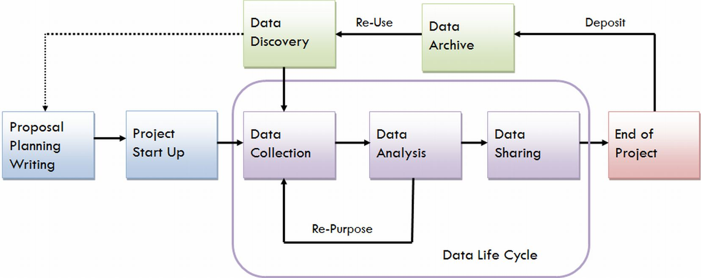
Research Data Lifecycle
https://data.library.virginia.edu/files/Research-Life-Cycle-LG.png

Slide 8
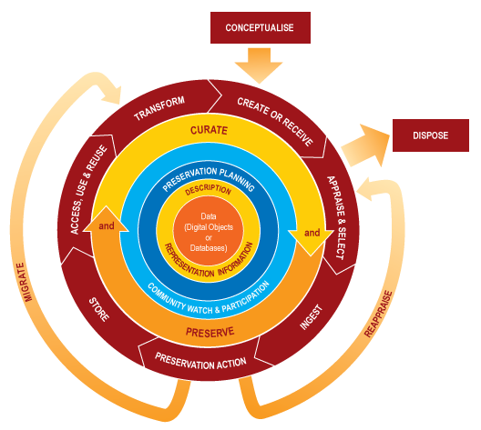
Data Curation Lifecycle
http://www.dcc.ac.uk/resources/curation-lifecycle-model

Slide 9

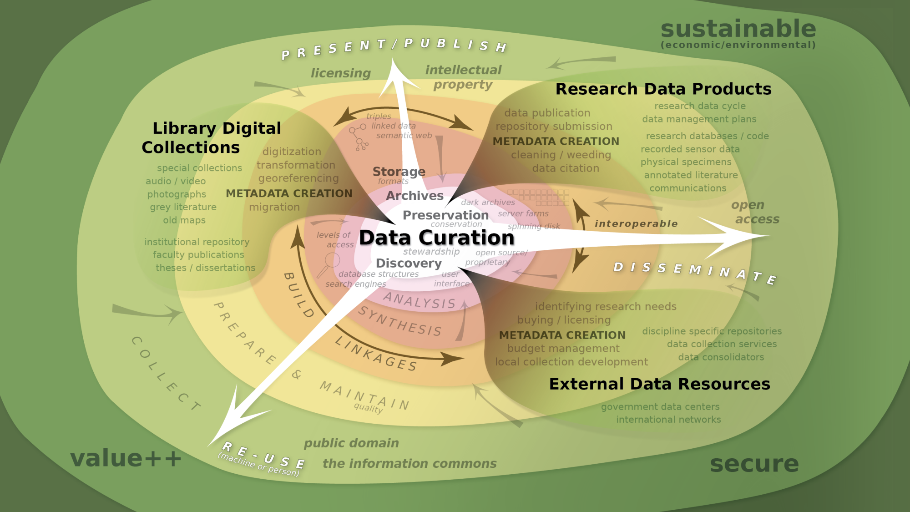
Notes:
So we are left with this complex view (strategic pause)
Re-emphasize the role of the curator as a collaborator in the creation of metadata and a builder of relationships.
Copyright and access metadata? Who polices? Is the metadata stable? Are links persistant? GATEKEEPERS
(illustrator 20)

Slide 10
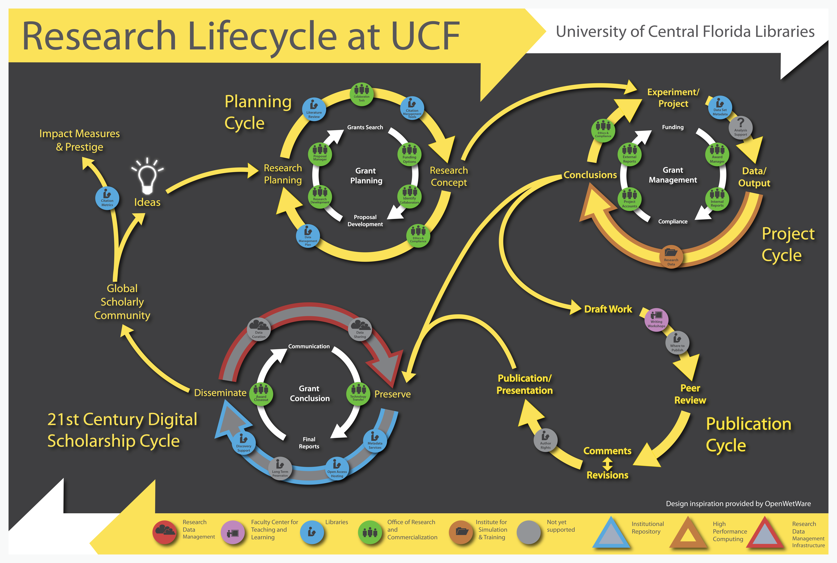
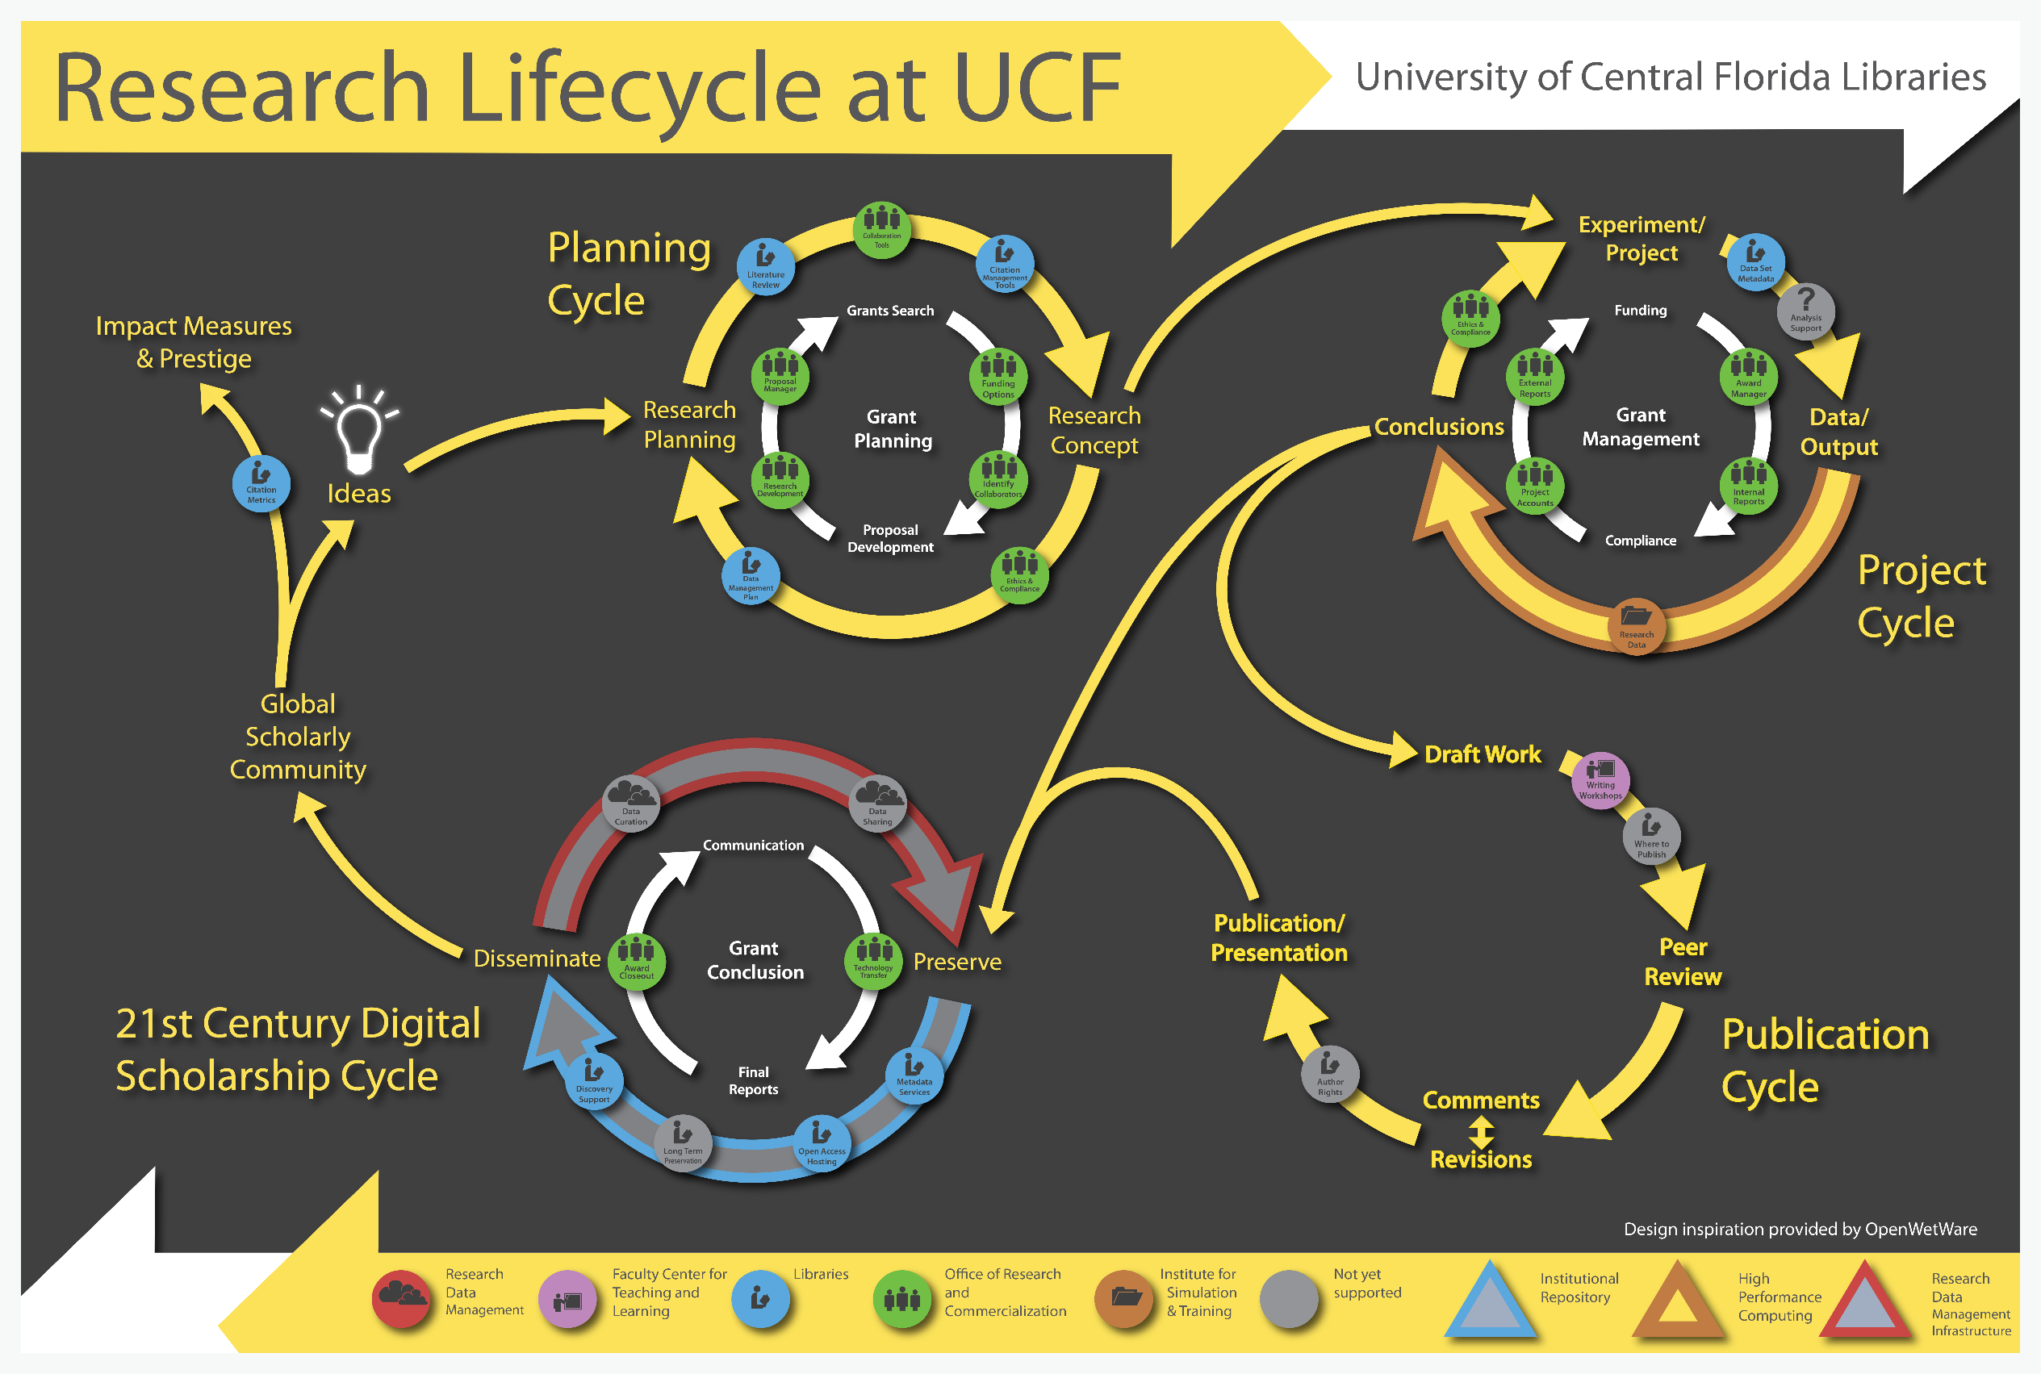

Slide 11

and Research DATA Management?
Before: Data Management Planning / Grant Process
During: Compliance and Productivity
During: Compliance and Productivity
After: Publication and/or Repository Deposit
After: Publication and/or Repository Deposit
Notes:
The Matrix - 1999
Big Data . . .
Talk to the data deluge, what are the responses in academia? In the public sector? Perhaps this is why we are here today?
NIH early data sharing requirements from grants over $500,000 – stringent controls for privacy and proprietary data
The 2011 NSF requirement to have data management plans in the grant proposals – there are program specific requirements
Most are simply two page documents with requirements to outline:
Data types to be collected
Standards to be used for metadata and data
Sharing policies (access, privacy, IP, etc.)
Re-use policies (distribution, derivatives
Plans for archival
Note that these requirements caused quite the scramble. No grant money if you could not include a plan.
Note that many foundations now also have data management requirements
Even private sector contracts require data management planning

Slide 12
and Research DATA Management?
Before: Data Management Planning / Grant Process
Privacy/Security Considerations
Storage and backup strategies
File System Organization
File Naming Conventions
File Format Choice
Documentation and metadata
Roles and responsibilities in research environment
Sharing and collaboration strategies
Ownership of data
Access strategies / Access restrictions
During: Compliance and Productivity
After: Publication and/or Repository Deposit
Notes:
The Matrix - 1999
Big Data . . .
Talk to the data deluge, what are the responses in academia? In the public sector? Perhaps this is why we are here today?
NIH early data sharing requirements from grants over $500,000 – stringent controls for privacy and proprietary data
The 2011 NSF requirement to have data management plans in the grant proposals – there are program specific requirements
Most are simply two page documents with requirements to outline:
Data types to be collected
Standards to be used for metadata and data
Sharing policies (access, privacy, IP, etc.)
Re-use policies (distribution, derivatives
Plans for archival
Note that these requirements caused quite the scramble. No grant money if you could not include a plan.
Note that many foundations now also have data management requirements
Even private sector contracts require data management planning

Slide 13
and Research DATA Management?
Before: Data Management Planning / Grant Process
During: Compliance and Productivity
Follow file naming, organization and format conventions
Documentation and metadata
Acquiring and cleaning data
Regularly backup all data
Be mindful when sharing / version control
Access / privacy policy enforcement
After: Publication and/or Repository Deposit
Notes:
The Matrix - 1999
Big Data . . .
Talk to the data deluge, what are the responses in academia? In the public sector? Perhaps this is why we are here today?
NIH early data sharing requirements from grants over $500,000 – stringent controls for privacy and proprietary data
The 2011 NSF requirement to have data management plans in the grant proposals – there are program specific requirements
Most are simply two page documents with requirements to outline:
Data types to be collected
Standards to be used for metadata and data
Sharing policies (access, privacy, IP, etc.)
Re-use policies (distribution, derivatives
Plans for archival
Note that these requirements caused quite the scramble. No grant money if you could not include a plan.
Note that many foundations now also have data management requirements
Even private sector contracts require data management planning

Slide 14
and Research DATA Management?
Before: Data Management Planning / Grant Process
During: Compliance and Productivity
After: Publication and/or Repository Deposit
Publish
Deposit in a repository
Notes:
The Matrix - 1999
Big Data . . .
Talk to the data deluge, what are the responses in academia? In the public sector? Perhaps this is why we are here today?
NIH early data sharing requirements from grants over $500,000 – stringent controls for privacy and proprietary data
The 2011 NSF requirement to have data management plans in the grant proposals – there are program specific requirements
Most are simply two page documents with requirements to outline:
Data types to be collected
Standards to be used for metadata and data
Sharing policies (access, privacy, IP, etc.)
Re-use policies (distribution, derivatives
Plans for archival
Note that these requirements caused quite the scramble. No grant money if you could not include a plan.
Note that many foundations now also have data management requirements
Even private sector contracts require data management planning

Slide 15
Promoting the Stewardship of Research Data
National Academy of the Sciences –
Committee on Ensuring the Utility and Integrity of Research Data in a Digital Age
Committee on Science, Engineering, and Public Policy
Policy and Global Affairs
Institute of Medicine;
Keywords?
Value
how does the value of data change over time?
why is some data more valuable than others?
what kinds of value are there?

Slide 16
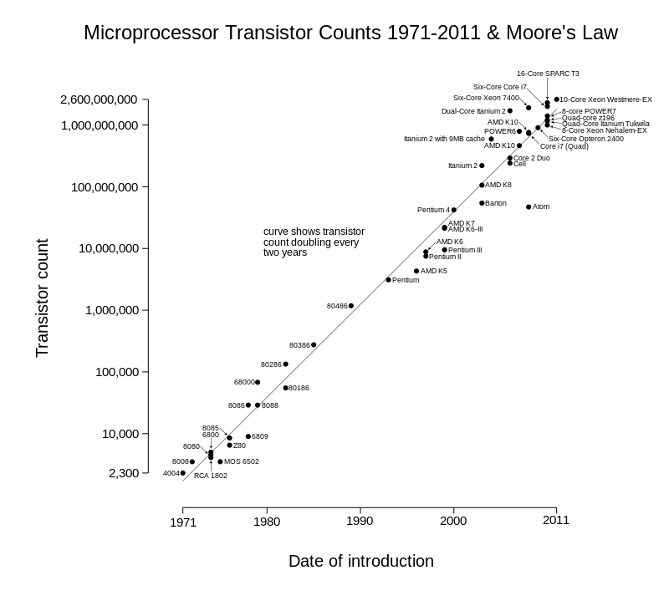
Wgsimon (2011), Licensed under CC BY-SA 3.0 via Commons
https://en.wikipedia.org/wiki/Moore's_law#/media/File:Transistor_Count_and_Moore%27s_Law_-_2011.svg

Slide 17
The 2013 OMB Memorandum
Value – “manage information as an asset throughout its lifecycle”
Privacy, security, ownership
Data:
“refers to all structured information, unless otherwise noted.”
Information Life Cycle
“means the stages through which information passes, typically characterized as creation, collection processing, dissemination, use, storage, and disposition.”

Slide 18
The 2013 OMB Memorandum
Policy Requirements
Collect information in a way that supports downstream use
Machine readable formats
Use data standards
Open licenses
Common core and extensible metadata
https://project-open-data.cio.gov/v1.1/schema/

Slide 19




Federal movement toward open data
1985: National Research Council
1999: OMB Circular A-110 revisions
2003: NIH Data Sharing Policy
2008: NIH Public Access Policy
2011: NSF DMP requirement
2012: NEH, Office of Digital Humanities DMP requirement
2013: NSF bio-sketch change
2013: OSTP memo on public access to results of federally funded data
Whitmire, Amanda L. (2014). Research Data Management Curriculum, Lecture 2: Introduction to Research Data Management. Oregon State University Libraries. Retrieved 11/04/2015 from: http://figshare.com/articles/GRAD521_Research_Data_Management_Lectures/1003835
Notes:
The push for improved data management and sharing has really been made by the federal government, including the Executive Office of the President and individual funding agencies. Here’s a brief timeline:
1985: National Research Council releases a book through the National Academies Press titled, “Sharing Research Data.” Makes recommendation that “Sharing research data should be a regular practice.” http://www.nap.edu/openbook.php?record_id=2033
11/19/93, amended 9/30/99: OMB Circular A-110 “Uniform Administrative Requirements for Grants and Agreements With Institutions of Higher Education, Hospitals, and Other Non-Profit Organizations” – all scientific data, including notebooks, must be maintained for three years [after a project concludes] in order to be able to comply with FOIA requests.
October 1, 2003: NIH institutes data sharing policy: “all investigator-initiated applications with direct costs greater than $500,000 in any single year will be expected to address data sharing in their application.” The NIH funds approximately 50,000 research grants per year with a research budget of $16-17B.
2008 NIH public access policy: “The Director of the National Institutes of Health ("NIH") shall require in the current fiscal year and thereafter that all investigators funded by the NIH submit or have submitted for them to the National Library of Medicine's PubMed Central an electronic version of their final, peer-reviewed manuscripts upon acceptance for publication, to be made publicly available no later than 12 months after the official date of publication: Provided, that the NIH shall implement the public access policy in a manner consistent with copyright law.” http://publicaccess.nih.gov/policy.htm
January 18, 2011: NSF starts requiring a 2-page data management plan with ALL proposals. The NSF funds approximately 11,500 grants per year with $7B in grant funding.
2012 NEH Office of Digital Humanities DMP requirement: http://www.neh.gov/files/grants/data_management_plans_2014.pdf
2013 NSF biosketch change, includes datasets as “products of work”. “Instructions for preparation of the Biographical Sketch have been revised to rename the "Publications" section to "Products" and amend terminology and instructions accordingly. This change makes clear that products may include, but are not limited to, publications, data sets, software, patents, and copyrights. “ http://www.nsf.gov/pubs/2013/nsf13004/nsf13004.jsp
Slide adapted from: Heather Coates, Data Management Lab: Session 1 Slides
http://www.slideshare.net/goldenphizzwizards/data-mgmtlab-spr14mod1slides201403245

Slide 20
The 2013 OSTP Memo
Transparency and efficiency
Growth, security, value
Commercial re-use and innovation
Data (from OMB Circular 110):
“Data is defined … as the digitally recorded factual material commonly accepted in the scientific community as necessary to validate research findings including data sets used to support scholarly publications, but does not include laboratory notebooks, preliminary analyses, drafts of scientific papers, plans for future research, peer review reports, communications with colleagues, or physical objects, such as laboratory specimens.”
Lots of Sticks!

Slide 21
Agency Response to OSTP 2013 Memo (agencies affected so far)
 |  |  | Policy Coverage
Funder | Link to Response | Timeline to Implement | Published Outputs | Data
AHRQ | http://www.ahrq.gov/funding/policies/publicaccess/index.html | Feb 2015 (A), Oct 2015 (D) | full | full
ASPR | http://www.phe.gov/Preparedness/planning/science/Pages/AccessPlan.aspx | Oct 2015 (A, D) | full | full
CDC | http://www.cdc.gov/od/science/docs/Final-CDC-Public-Access-Plan-Jan-2015_508-Compliant.pdf | Jul 2013 (A), Oct 2015 (D) | full | full
DOD | http://www.dtic.mil/dtic/pdf/DoD_PublicAccessPlan_Feb2015.pdf | estimate fiscal year 2015 | full | full
DOE | http://www.energy.gov/datamanagement/doe-policy-digital-research-data-management | Oct 2014 (A) Oct 2015 (D) | full | full
DOT | https://www.transportation.gov/open/official-dot-public-access-plan | Jan 2016 | full | TBD
FDA | http://www.fda.gov/downloads/ScienceResearch/AboutScienceResearchatFDA/UCM435418.pdf | Oct 2015 (A, D) | full | full
NASA | http://science.nasa.gov/media/medialibrary/2014/12/05/NASA_Plan_for_increasing_access_to_results_of_federally_funded_research.pdf | Oct 2015 (A, D) | full | full
NIH | http://grants.nih.gov/grants/NIH-Public-Access-Plan.pdf | In effect (A, D), Dec 2015 (D) | full | full
NIST | http://www.nist.gov/data/upload/NIST-Plan-for-Public-Access.pdf | Oct. 2015 (A, D) | partial | full
NOAA | http://docs.lib.noaa.gov/noaa_documents/NOAA_Research_Council/NOAA_PARR_Plan_v5.04.pdf | FY2016, Q2 (A, D) (Jan 2016) | full | full
NSF | http://www.nsf.gov/pubs/2015/nsf15052/nsf15052.pdf | Jan 2016 (A, D) | Full | Full
SI | http://public.media.smithsonianmag.com//file_upload_plugin/1f143b54-a9f9-4746-bef5-1c76151e3c7a.pdf | Oct. 2015 (A, D) | full | full
USDA | http://www.usda.gov/documents/USDA-Public-Access-Implementation-Plan.pdf | Jan 2016 (A) | Full | Partial
USAID | http://blog.usaid.gov/2014/10/announcing-usaids-open-data-policy/ | October 1, 2014 (D) | none | Full
USGS | http://www.usgs.gov/usgs-manual/im/IM-OSQI-2015-01.html | Feb 19, 2015 (D) |  | full
VA | http://www.va.gov/ORO/Docs/Guidance/VA_RSCH_DATA_ACCESS_PLAN_07_23_2015.pdf | October 1, 2015 (A, D) | partial | Partial
http://bit.ly/FedOASummary

Slide 22
The memorandum states that, “digitally formatted scientific data resulting from unclassified research supported wholly or in part by Federal funding should be stored and publicly accessible to search, retrieve, and analyze.” To this end, federal agencies must create a public access plan that includes the following mandates:
Maximize public access to data while protecting personal privacy and confidentiality, intellectual property, and balancing costs with long-term benefits;
Ensure that investigators create data management plans that describe strategies for long-term preservation of and access to data;
Costs of data management are included in proposal budgets;
Ensure that the merits of data management plans are properly evaluated;
Implement mechanisms to ensure that investigators comply with their data management plans and policies;
Promote deposition of data into publicly accessible repositories;
Encourage private and public cooperation to improve data access and interoperability;
Develop and standardize approaches to data citation/attribution;
Support training in data management best practices;
Assess needs and strategies for the long-term preservation of data.
Slide from Whitmire, Amanda L. (2014). Research Data Management Curriculum, Lecture 2: Introduction to Research Data Management. Oregon State University Libraries. Retrieved 11/04/2015 from: http://figshare.com/articles/GRAD521_Research_Data_Management_Lectures/1003835
Notes:
Slide from Whitmire, Amanda L. (2014). Research Data Management Curriculum, Lecture 2: Introduction to Research Data Management. Oregon State University Libraries. Retrieved 11/04/2015 from: http://figshare.com/articles/GRAD521_Research_Data_Management_Lectures/1003835

Slide 23
What is a Data Management Plan?
The Data Management Plan is a written document that describes the data you expect to acquire or collect throughout a research project, how you will collect, organize, document, and analyze the data, and finally how you will share, publish and preserve the data.

Slide 24
Data Management Plans
Information about Data and Data Formats
Metadata Content and Format
Policies for access sharing and re-use
Long-term storage and preservation
Budget

Slide 25
1. Data and Data Formats (week 3, week 4, week 5, Software Carpentry, week 11)
Data Types
How will they be collected
How will the data be processed
File Formats
Quality Control
Existing Data
Short-term management

Slide 26
2. Metadata Content and Format (week 8)
metadata is a description of your data for a future user (you perhaps?)
What does this person need to know to use the data properly?
Does this person need discipline specific knowledge? How much?
Two general kinds of metadata
Project level (contextual)
Technical (data level, units, headers, etc.)
How will the metadata be captured
Notebooks (electronic)
Device capture
What format (with justification)
Discipline specific standard? Other standard?
Machine or human readable (both?)

Slide 27
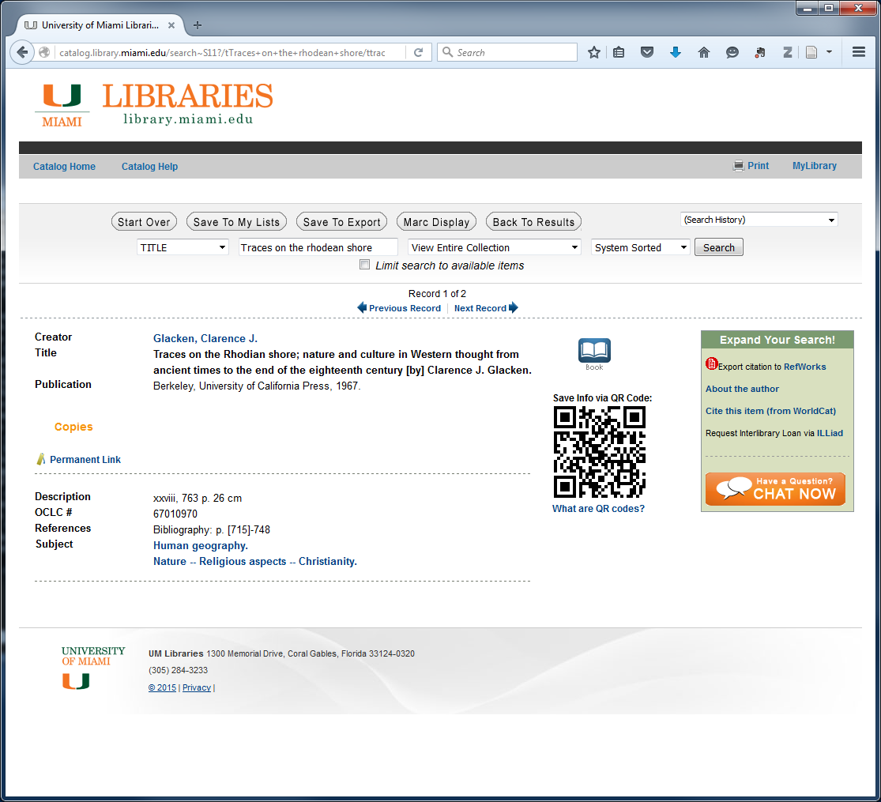
Metadata that you know already human readable

Slide 28
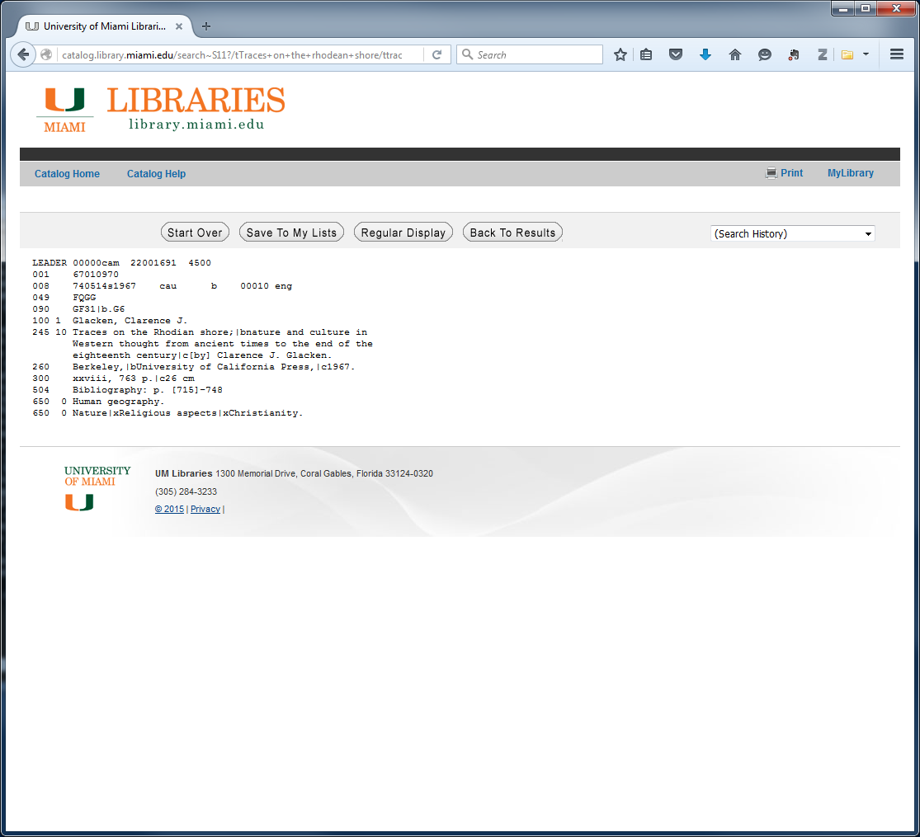
Metadata that you know already machine readable

Slide 29
3. Policies for Access and Sharing (week 12, week 13)
Data sharing details
How long, where, how accessed, rights of data collector
Ethical or Privacy Issues
Personally identifiable data, endangered species, fragile habitats
Ownership
Who owns the data, institutional or funder requirements, embargoes
Intended future audience
Who will want to use this data, why
Citation
Provide a citation, DOI, ARK

Slide 30
3. Policies for Re-use and Distribution (week 12, week 13)
Permissions or restrictions
How can the data be re-used
License type
Open data?
http://opendatacommons.org/licenses/
Open Data Licenses
Public Domain Dedication and License (PDDL) — “Public Domain for data/databases”
Attribution License (ODC-By) — “Attribution for data/databases”
Open Database License (ODC-ODbL) — “Attribution Share-Alike for data/databases”

Slide 31
4. Archival and Preservation Plans (week 13)
What data will be preserved
Raw data? Data that was expensive to collect? Non-replaceable data?
Where will the data be preserved/archived
Identify the data repository that you will use
Are there data transformations necessary for archiving
What will the final format of the archived data be? Needed software for opening particular file formats?
Who will be responsible
Contact person(s)

Slide 32
5. Budget
Expected money needed for
Preparation of data and documentation
Hardware/software?
Archival costs/rental of disk space?
Who is going to pay these costs
Grant proportion
Other sources
In kind

Slide 33
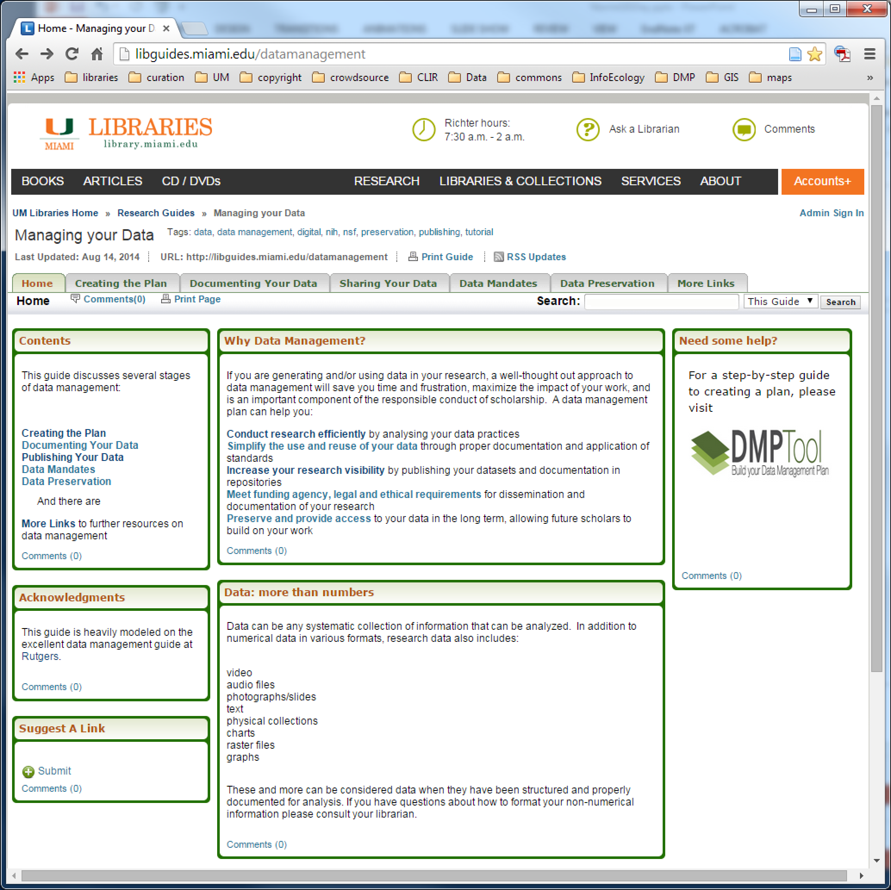

Slide 34
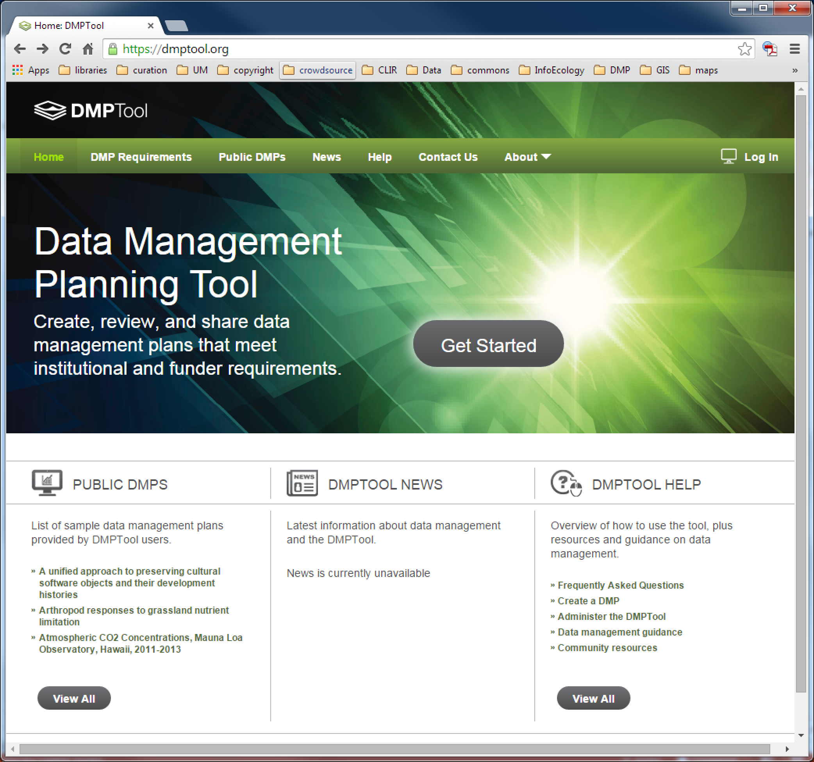

Slide 35
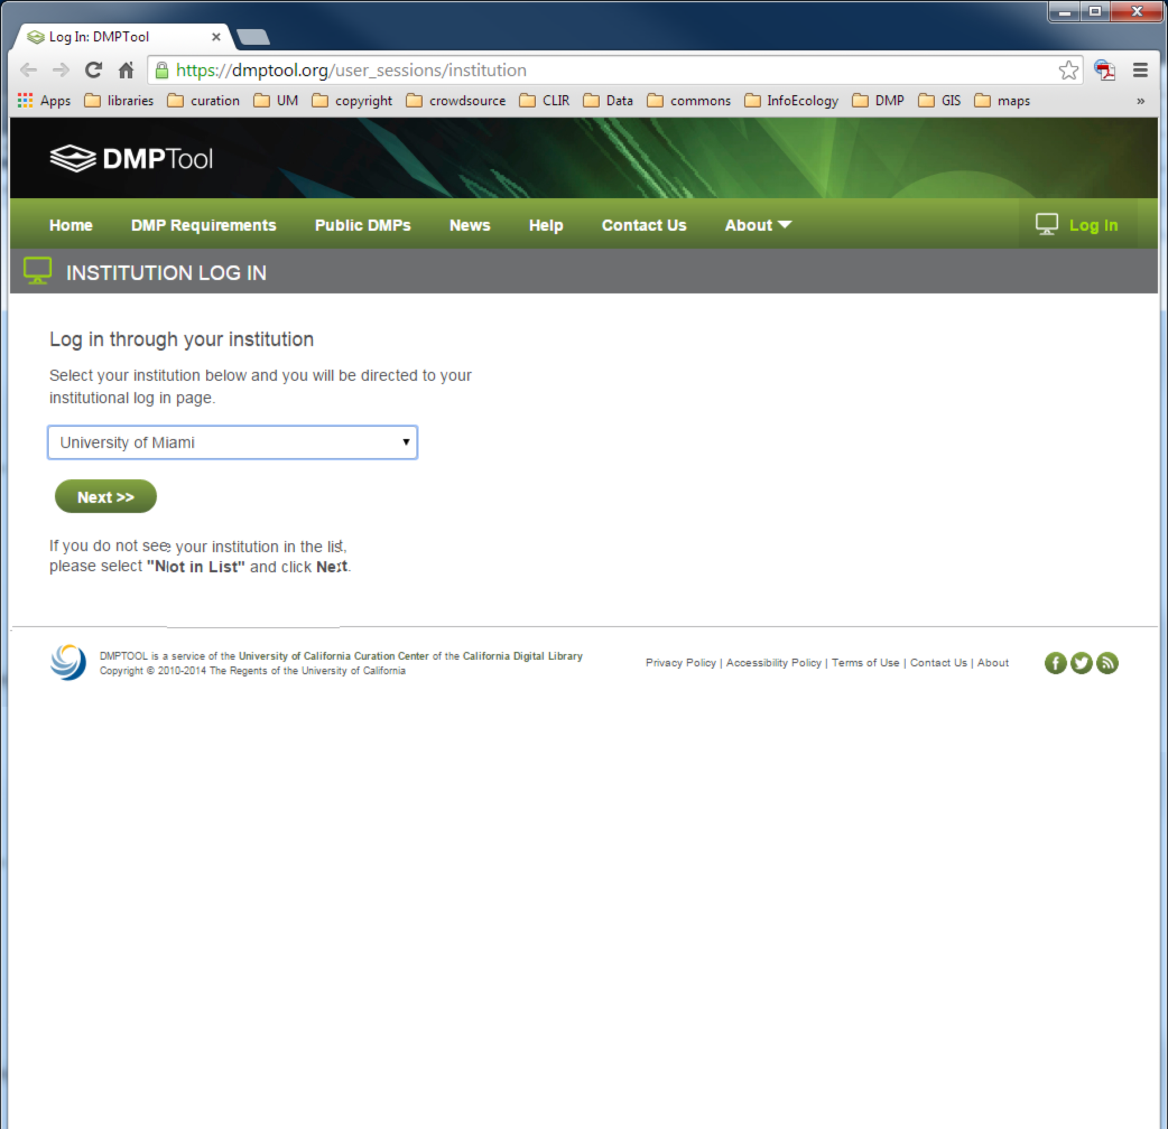

Slide 36
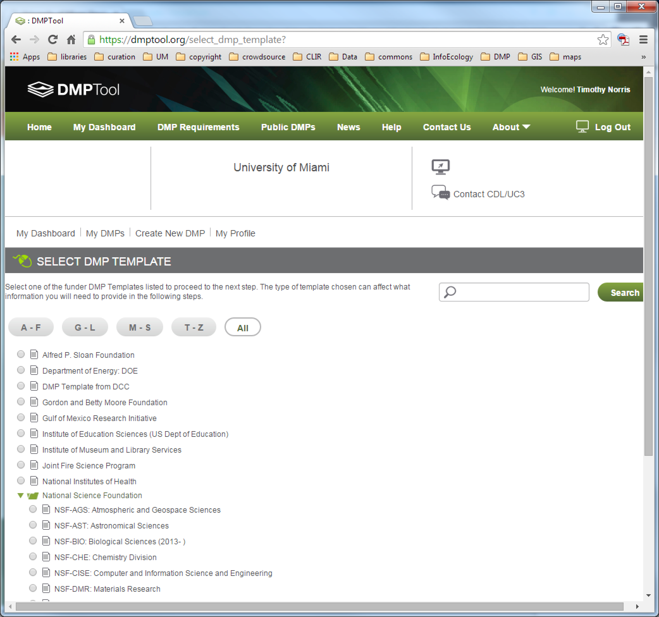

Slide 37



https://dmponline.dcc.ac.uk/

Slide 38
Quick Review: Data Management Plans
Information about Data and Data Formats
Metadata Content and Format
Policies for access sharing and re-use
Long-term storage and preservation
Budget
BUT it always will depend on your goals and the funder’s goals

Slide 39


Why Manage Data
X
Productivity
Publishing
Knowledge creation
Career advancement
+
Compliance
Grant writing
University policy
Research ethics
http://www.pd4pic.com/images800_/carrot-orange-vegetable.png
http://www.pd4pic.com/images/stick-outline-tree-branch-wood.png
Notes:
The Matrix - 1999
Big Data . . .
Talk to the data deluge, what are the responses in academia? In the public sector? Perhaps this is why we are here today?
NIH early data sharing requirements from grants over $500,000 – stringent controls for privacy and proprietary data
The 2011 NSF requirement to have data management plans in the grant proposals – there are program specific requirements
Most are simply two page documents with requirements to outline:
Data types to be collected
Standards to be used for metadata and data
Sharing policies (access, privacy, IP, etc.)
Re-use policies (distribution, derivatives
Plans for archival
Note that these requirements caused quite the scramble. No grant money if you could not include a plan.
Note that many foundations now also have data management requirements
Even private sector contracts require data management planning

Slide 40
Evaluate a DMP
http://dmpresearch.library.oregonstate.edu/
Complete /detailed | Addressed issue, but not complete | Did not address
Describes what types of data will be captured, created or collected
Describes how data will be collected, captured, or created (whether new observations, results from models, reuse of other data, etc.)
Identifies how much data (volume) will be produced
Describes how the data will be made publicly available
Provides details on when the data will be made publicly available
Other Criteria???

Slide 41
Assignment #1
Write a one-page (maximum) evaluation of the strengths and weaknesses of a DMP (can be from your lab, your research or the DMP Tool website)
Due Next Wednesday January 27th by end of the day
Email to tnorris@miami.edu and aclark@rsmas.miami.edu
Filename: 201601<twoDigitDate>_<yourLastName>_RSM674.Assignment01.doc
ALSO: for next meeting (Monday the 25th) install a text editor on your machine! Suggestions: any OS: Gedit, Mac: TextWrangler, Windows: Notepad++)

Slide 42
Readings for Next Week (Kitchin before Monday’s class, the others will be useful before Monday, but not necessary (skim parts)
Kitchin, R (2014). “Conceptualizing Data” in Kitchin, R The Data Revolution. Washington DC: Sage. http://uk.sagepub.com/sites/default/files/upm-binaries/63923_Kitchin_CH1.pdf
UK Data Archive (2015). Create and Manage Data: formatting Your Data: File Formats and Software. http://www.data-archive.ac.uk/create-manage/format/formats. (follow “Recommended File Formats” link as well).
Library of Congress (2015). Recommended Formats Statement 2015-2016. https://www.loc.gov/preservation/resources/rfs/RFS%202015-2016.pdf.

